Slide 1



Admin Training
Supplier Management

Slide 2
Learning Objectives Supplier Management
Teach
(Slides)
Show
(Demo)
Do
(Exercises)
Review
(Q&A)
Supplier Management Overview
Suppliers Workspace Setup
Supplier Workflow Approval
Adding Sourcing to Items
Creating Quotes
BOM Cost Rollup

Slide 3

Supplier Management Overview
Supply and Procurement applications help everyone in the organization involved with the negotiation, purchase, and receipt of goods and services
Sourcing and Costing
Capture component costs, and view rolled up cost totals in your BOMs. Track the suppliers of each component and their quotes, and set the price and default vendor. Your BOMs are automatically updated with cost and supplier part numbers.
Warranty Recovery
Open claims on failed items to notify those affected, organize replacement, and collect refunds. Record claims immediately upon discovery of loss or damage from anywhere, using any device. Easily monitor vendor performance by reviewing the warranty history of all items received.
Supplier Evaluations
An online source of accurate information vital to conducting day-to-day business with partners. Stay abreast of recent developments by referencing notable events and details of all items supplied. Assemble a detailed record of agreements that includes final contracts, item definitions, and costs.
Request for Quotation (RFQ)
Collect and compare supplier offers to maximize the value of purchased goods and services. Speed offer negotiations by designating specific buyer and technical supplier contacts. Clearly understand each offer by reviewing a complete listing of all items and drawings for quote.

Slide 4
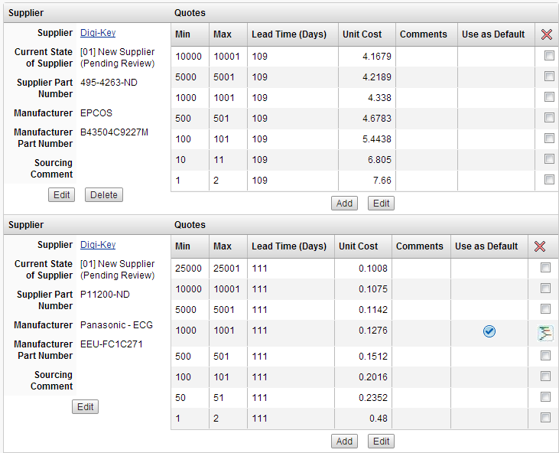
Supplier Management Overview
Access Controls
Sourcing Data
Costing Visibility
Supplier Restriction by IP
Access Logging
Automatic Notifications
Configurable Reports

Slide 5
Supplier Management
Track: Suppliers of each component and their quotes, and set the price and default vendor
Maintain: An approved vendor list (AVL) with optional workflow for approving and evaluating vendors
Manage: Full vendor management functionality

Slide 6
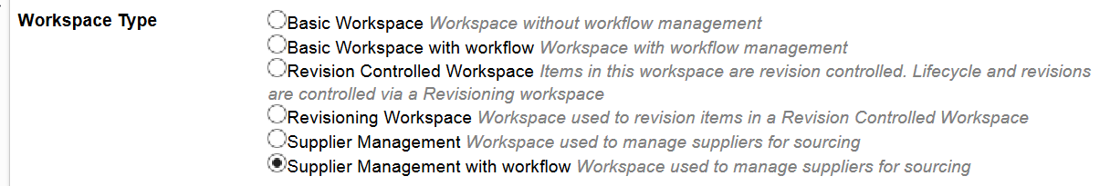
Suppliers Workspace Setup
Workspace Type: Supplier Management
With or without workflow
Automated features and connection to Sourcing tabs
Notes:
Remember this screenshot?

Slide 7
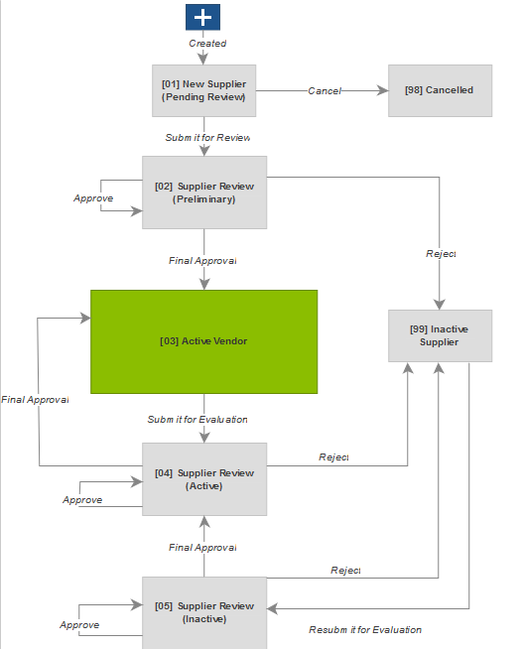
Supplier Workflow Approval
Out of the Cloud provides workflow and logic for vendor evaluation
Supplier workflow state displayed on Supplier record and in Sourcing tab of item
Supplier Workflow can be customized to your business needs

Slide 8
Add a Sourcing Vendor
Add a supplier / sourcing vendor for an item: on the item’s Sourcing tab, click Add.
In the Supplier drop-down list, you will see the records in your supplier / vendor management workspace.
Select a supplier to add. If there is workflow process for the supplier / vendor management workspace, the state of the selected supplier displays.

Slide 9
Add Quotes
In the Sourcing tab, add quotes for each supplier-item relationship.
In the Quotes column, next to the supplier where you want to add quotes, click Add.
Enter the minimum and maximum order quantity, the lead time, the cost per unit and any comments.
You can enter any number of quotes for each vendor.

Slide 10
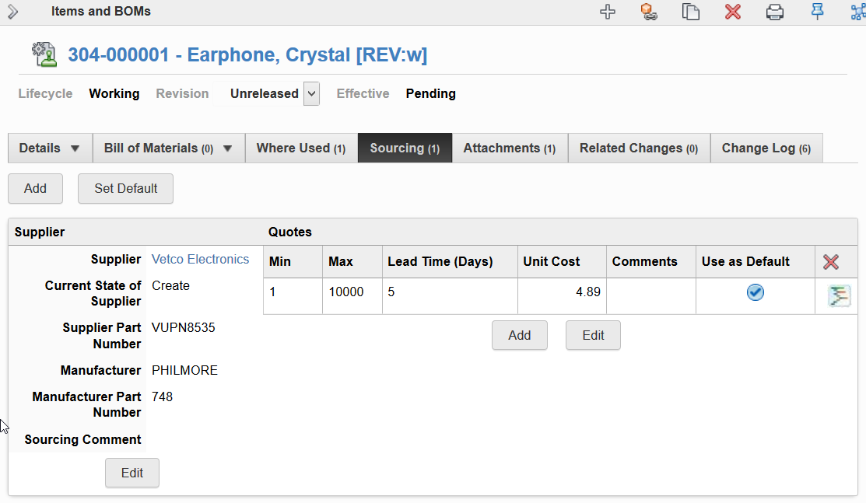
Sourcing Tab Layout
Any workspace of Supplier Management type will be the source for the “Suppliers” field in all Sourcing tabs
Unit Cost feeding into BOM Cost Rollup is entered here
Notes:
Remember this screenshot?

Slide 11
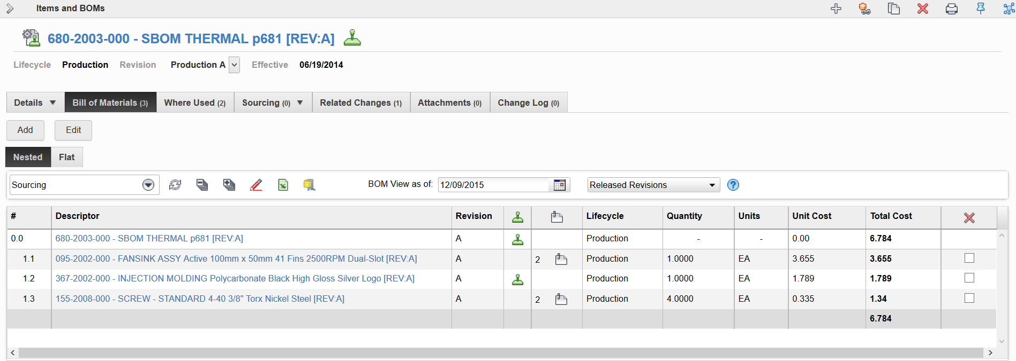
BOM Cost Rollup
Child items have sourcing quotes filled out
Total Cost is automatically calculated on Parent BOM

Slide 12
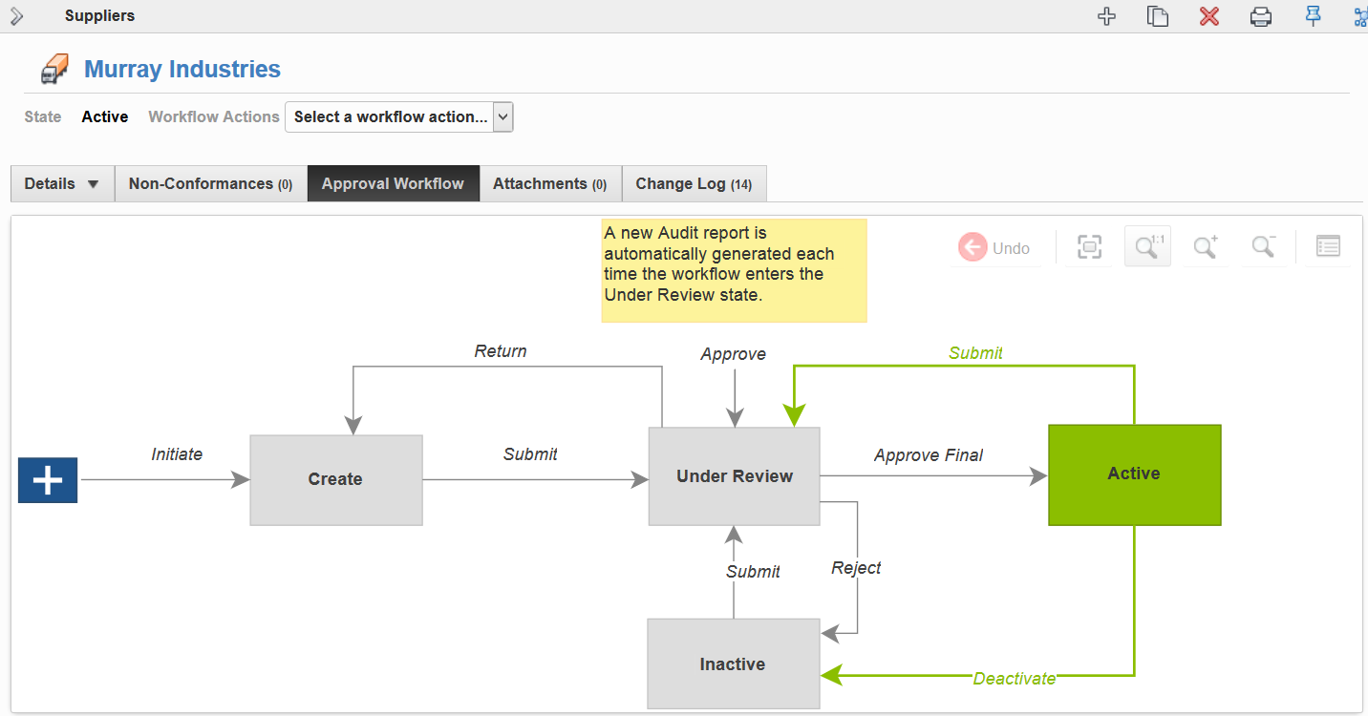
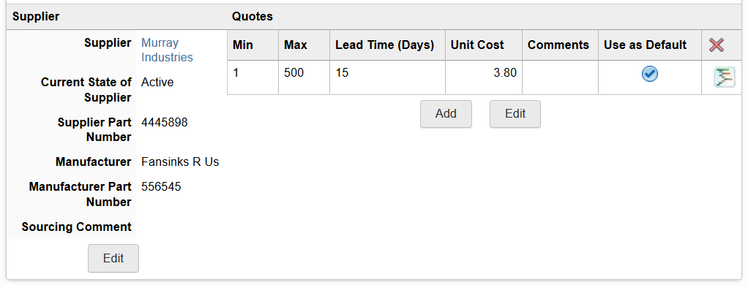
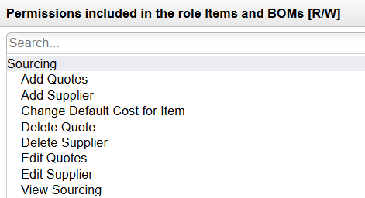
Teach
(Slides)
Show
(Demo)
Do
(Exercises)
Review
(Q&A)
Demo Topics Supplier Management
Exploring Suppliers Workspace
Create a new Supplier
Qualify the new Supplier
Enabling Sourcing Tab for Items and BOMs
Sourcing for Items
Add Sourcing
View cost rollup in parent BOM

Slide 13
Exercises 1 - 4
Teach
(Slides)
Show
(Demo)
Do
(Exercises)
Review
(Q&A)

Slide 14
Review Supplier Management
Teach
(Slides)
Show
(Demo)
Do
(Exercises)
Review
(Q&A)
Supplier Management Overview
Suppliers Workspace Setup
Supplier Workflow Approval
Adding Sourcing to Items
Creating Quotes
BOM Cost Rollup

